Slide 2
Introduction
Name the two type of nucleic acid found in living organism.
Deoxyribonucleic acid (DNA) & Ribonucleic acid (RNA)
What act as the genetic material in most of the living organism? DNA
In virus what act as the genetic material other than DNA? RNA
List some functions of RNA Messenger, catalytic molecule

Slide 3
Nucleic Acids.
Nucleic acids are the macromolecules present in all living cell.
Freidrich Miescher was the first person isolated the nucleic acids from the pus cells. He called it as nuclein.
As it has an acidic nature, hence Altmann called it as nucleic acids.
The two types of nucleic acids found in living organisms are,
Deoxyribonucleic acid [DNA]
Ribonucleic acid [RNA].

Slide 4
Deoxyribonucleic acid [DNA]
Genetic material of all living organisms- carries the coded information
from one generation to another generation.
In eukaryotic cell DNA is found nucleus. It is the chief component of chromosomes.
DNA also found in the mitochondria and chloroplasts
Long polymer of deoxyribonucleotides.
Length of the DNA - number of nucleotides or pair of nucleotide (base
pairs)
Eg. Bacteriophage- ɸ 174- 5386 nucleotides, Bacteriophage lambda- 48502 base pair (bp), human DNA- 3.3 X 10⁹ bp.

Slide 5
Structure of polynucleotide chain
DNA & RNA - polynucleotide chain
A nucleotide – 3 components
A nitrogenous base
A pentose sugar (DNA- deoxyribose sugar, RNA- Ribose sugar)
A phosphate group
Nitrogenous base- Nitrogen containing compound
Two types- Purines (Adenine & Guanine) & Pyrimidines (Cytosine, Uracil & Thymine)
Adenine, Guanine & Cytosine- Both DNA & RNA
Thymine- only in DNA
Uracil- Only in RNA in place of Thymine
Nitrogenous Base linked is linked to pentose sugar through N- glycosidic linkage- Nucleoside

Slide 6
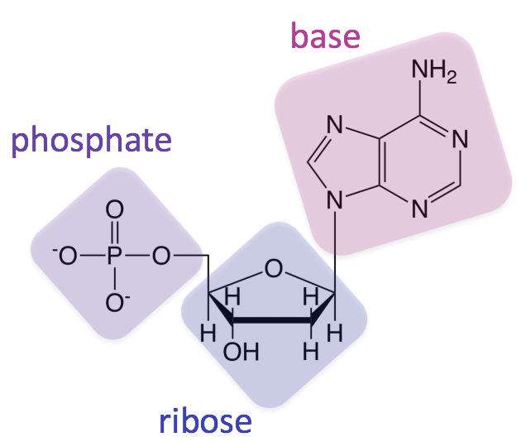

Slide 7
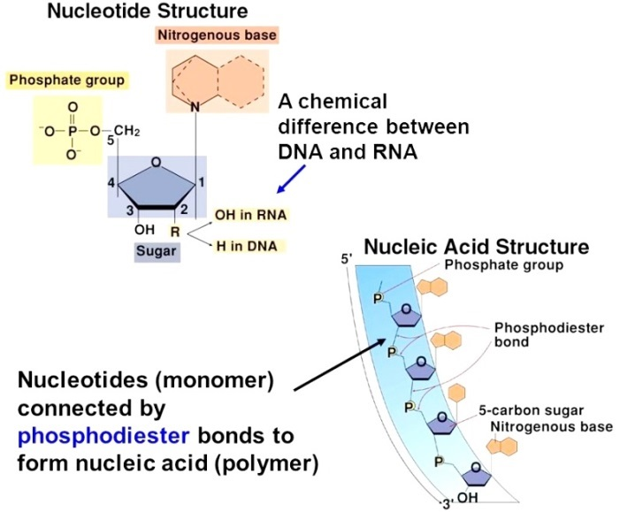

Slide 8
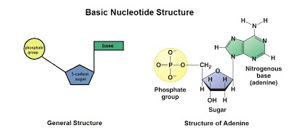

Slide 9
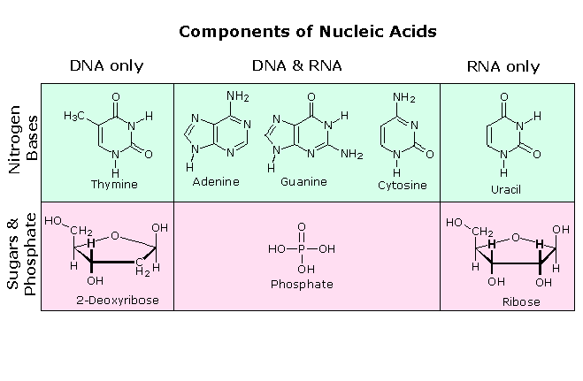
Nucleoside- : compounds formed by the combination of Pentose sugar
and Nitrogenous base
In DNA molecule- Deoxyribose sugar combines with nitrogenous base & form Deoxyribonucleoside
Adenine + deoxyribose sugar = Deoxyadenosine
Guanine + deoxyribose sugar = Deoxygaunosine.
Cytosine + deoxyribose sugar = Deoxycytidine.
Thymine + deoxyribose sugar =Deoxythymidine

Slide 10
Nucleotides: The compound formed by the combination of phosphate
groups with nucleosides is called nucleotides.
Phosphate group is linked to nucleoside through 5’- OH of nucleoside through phosphoester linkage- corresponding nucleotides (deoxyridonucleotide)
The four types of nucleotides present in the DNA are,
Deoxyadenosine monophosphate.
Deoxygaunosine monophosphate.
Deoxycytidine monophosphate.
Deoxythymidine monophosphate.

Slide 11
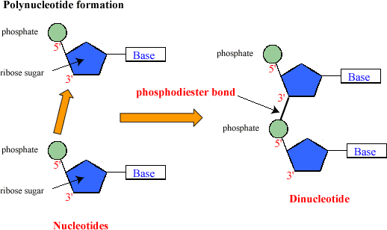
Polynucleotide strand:
Two nucleotides are linked through 3’- 5’ phosphodiester linkage- dinucleotide
The phospho-di-ester bond forms between 5th and 3rd carbon atom position of pentose sugar. Therefore polynucleotide strand contains 5th and 3rd end.
More nucleotides joins- polynucleotide, which has at one end free phosphate moiety at 5’ end - 5’- end of polynucleotide & free 3’-OH group- referred as 3’- end of polynucleotide
Sugar & phosphate- backbone & Nitrogenous base project form the
backbone

Slide 12
Structure of RNA
Structure of RNA is similar to DNA
Nucleotide residue has additional –OH group
-OH group is present at 2’- position in the ribose
Nitrogenous base Uracil is found in place of Thymine
Reads the template of DNA and forms the protein required for the cell

Slide 13
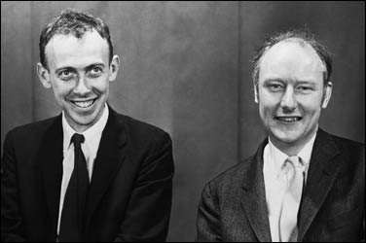
History- Structure of DNA- polynucleotide
James Watson and Francis Crick first proposed the structural model of DNA in 1953 based on the X- ray diffraction data- Maurice Wilkins & Rosalind Franklin
They got the Nobel Prize for their work in 1962.
Proposed Double Helix model for structure of DNA- remarkable proposition was base pairing between two strand of polynucleotide
Proposition depend on observation of Erwin Chargaff that for a double stranded DNA, the ratios between Adenine & Thymine ; Guanine & Cytosine are constant & equal
Base pairing- unique property of polynucleotide chain, complementary to each other- sequence of one DNA strand known then sequence of other strand can be predicted
Each strand of DNA (parental DNA)- template for synthesis of new strand- two double stranded DNA (daughter DNA) will be identical to parental DNA molecule

Slide 14
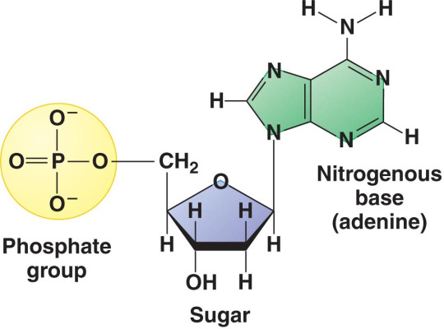

Slide 15
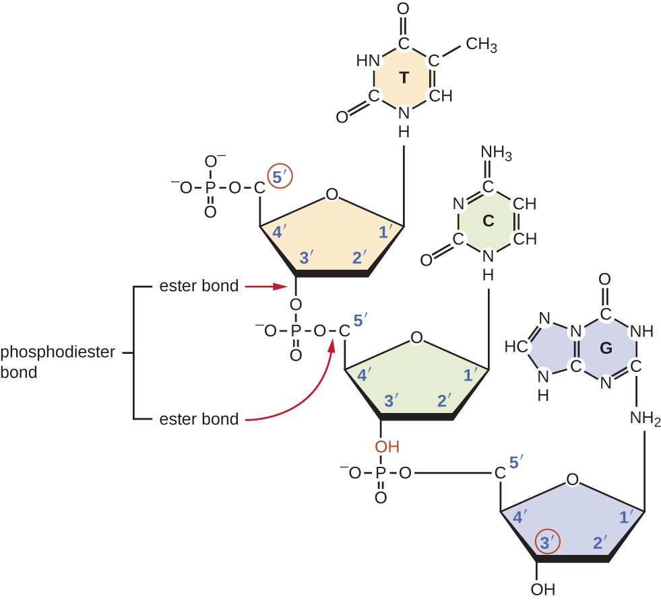

Slide 17
The structure of DNA is as follows:
Two polynucleotide chains- the backbone of polynucleotide is formed by sugar- phosphate & bases project inside
Two chains: anti- parallel polarity; one chain has polarity 5’→ 3’ &
other chain 3’→5’
Bases of two strand projecting inside- paired through hydrogen bond (H- bond) & form base pairs (bp)
Adenine form two hydrogen bonds (H- bond) with Thymine & Guanine
form three H- bond with Cytosine
Purines comes opposite with Pyrimidines- generates uniform distance between two strands of the helix
Adenine Thymine
Guanine
Cytosine

Slide 18
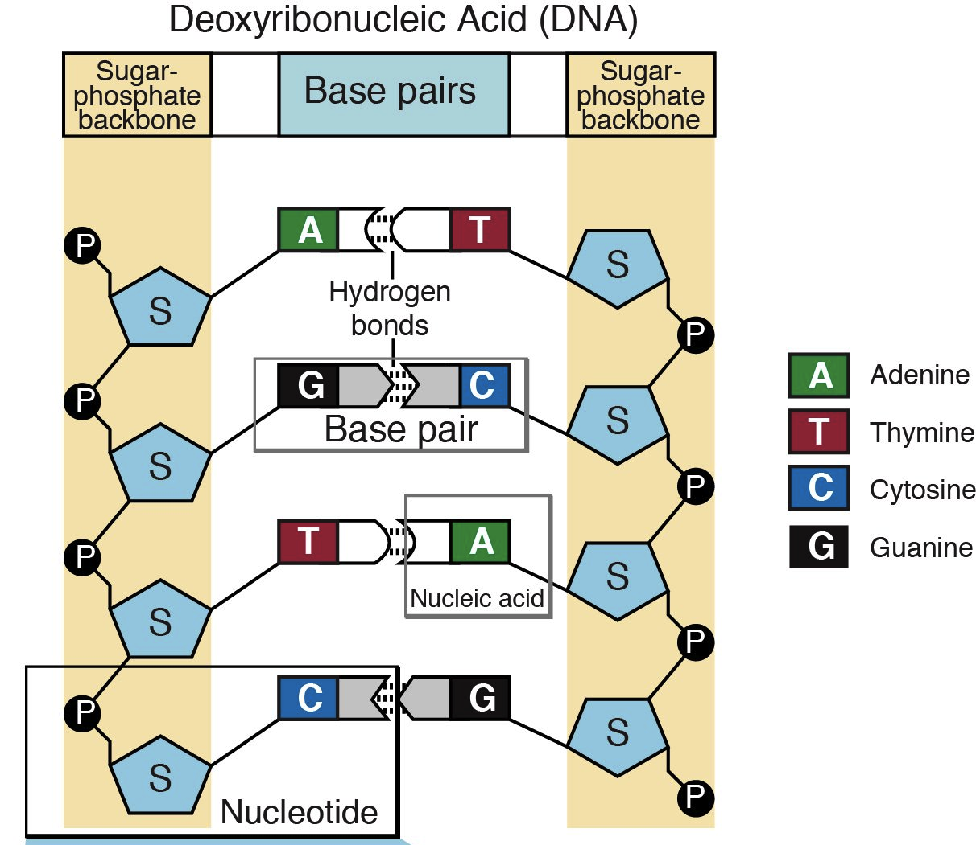

Slide 19
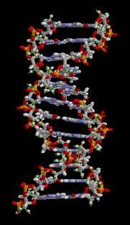
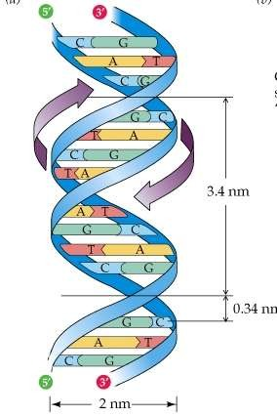
Two chains- coiled right handed fashion
Pitch of helix is 3.4 nm- The pitch of a helix is the width of one complete helix turn, measured parallel to the axis of the helix.
10 bp in each turn or pitch, distance between a bp in helix- 0.34nm
Plane of one base pair stacks over the other in double helix- addition to H-
bond confers stability
Stability of DNA structure : H- bond & stacking of nitrogenous base
Adenine
Thymine
Guanine
Cytosine

Slide 20
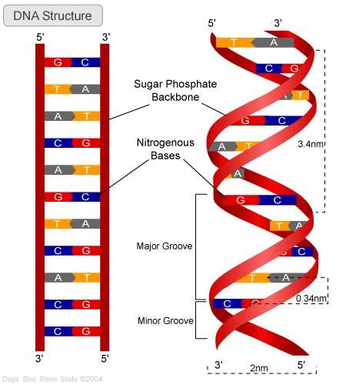

Slide 21
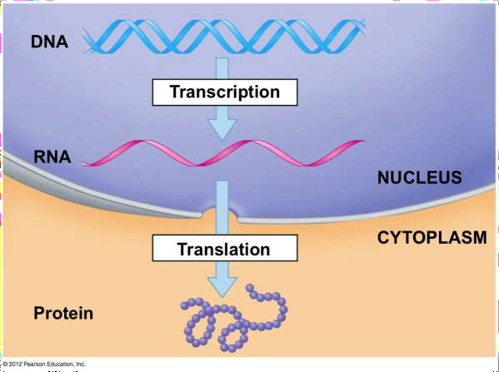
Francis Crick proposed Central dogma in molecular biology
Genetic information flows from DNA→ RNA→ Protein
The coded genetic information hard-wired into DNA is transcribed into individual transportable cassettes, composed of messenger RNA (mRNA); each mRNA cassette contains the program for synthesis of a particular protein (or small number of proteins)
DNA
Transcription
mRNA
Translation
Protein

Slide 22
Lets Practice- dna structure
1. Molecules of DNA are composed of long chains of
amino acids
fatty acids
monosaccharides
nucleotides
Ans.- Nucleotides
2. The primary function of DNA is to
make proteins
store and transmit genetic information
control chemical processes within cells
prevent mutations
Ans.- Make protein

Slide 23
3. A nucleotide consists of
a sugar, a protein, and adenine
a sugar, an amino acid, and a starch
a sugar, a phosphate group, and a nitrogen-containing base
a starch, a phosphate group, and a nitrogen-containing base
Ans.- A sugar, a phosphate group and a nitrogen containing base
4. The part of the molecule for which deoxyribonucleic acid is named
is
phosphate group
sugar
nitrogen base
none of the above
Ans.- Sugar

Slide 24
5. Purines and pyrimidines are
bases found in amino acids
able to replace phosphate groups from defective DNA
names of specific types of DNA molecules
bases found in nucleotides
Ans.- Bases found in nucleotides
6. The scientists credited with determining the structure of DNA are
Avery and Chargaff
Hershey and Chase
Mendel and Griffith
Watson and Crick
Ans.- Watson and Crick

Slide 25
7. The base-pairing rules state that the following are base pairs in DNA:
adenine - thymine; guanine - cytosine
adenine - thymine; uracil - cytosine
adenine - guanine; thymine - cytosine
uracil - thymine; guanine – cytosine
Ans.- Adenine- Thymine; Guanine- Cytosine
8. ATTG : TAAC ::
AAAT : TTTG
TCGG : AGAT
GTCC : CAGG
CGAA : TGCG
Ans.- GTCC: CAGG

Slide 26
Packaging of dna helix
Length of typical Double DNA helix in mammalian calculated as 2.2 meters
Cells- Eukaryotes & Prokaryotes
Eukaryotes DNA localized inside the nucleus
Prokaryotes like E. Coli- defined nucleus & DNA is not scattered throughout in cell
DNA- negatively charged; Protein- Positive charges
DNA held with positive charged Protein- region termed ‘Nucleoid’
DNA in nucleoid organized in large loops held by protein
Eukaryotes- organization is complex; DNA forms complex with positively charged protein- histones
Proteins acquires charge- abundance of amino acid residues lysines & arginines
Amino acid residue- positive charge in side chain

Slide 27
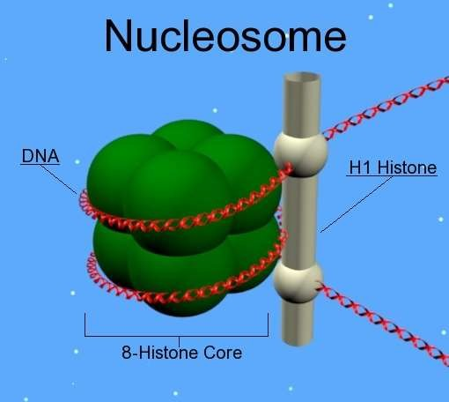
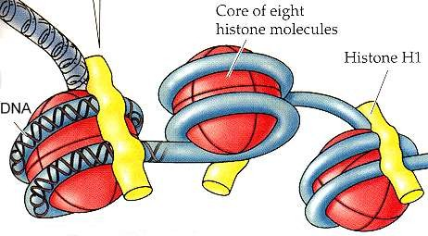
Histone:
Histones rich in amino acids- Lysines & Arginines
Histones organized- unit of eight molecules- histone octamer
DNA- negatively charged, wrap around positively charged histone octamer to form a structure- nucleosome
A typical nucleosome- 200 bp of DNA helix
Nucleosome is the repeating unit of a structure in a nucleus- Chromatin
Chromatin- thread like stained bodies in nucleus
Nucleosome in chromatin sees as- ‘beads on string’- Electron microscope

Slide 28
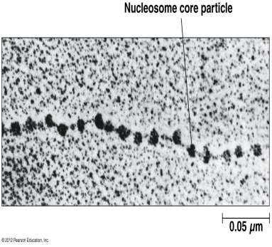
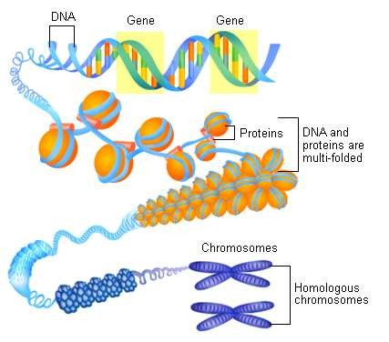
Beads- on- string structure in chromatin packaged- Chromatin fibers-
further coiled & condensed during Metaphase- Chromosomes
Packaging of chromatin require additional set of proteins- Non- histone Chromosomal (NHC) proteins
Typical nucleus- region of chromatin loosely packed- Euchromatin (transcriptionally active); chromatin densely packed- Heterochromatin (inactive)

Slide 29
The search for genetic material
Transforming Principle:
Principle or factor responsible for heredity in organism
1928, Frederick Griffith- series of experiments with Streptococcus pneumonia – bacteria causing Pneumonia
Observed change in the physical form of bacteria- transformation
Streptococcus pneumonia- grown in culture plate- two different
colonies observed
Smooth colony- S Strain: Mucous/ polysaccharide coat- Virulent
Rough colony- R Strain: Does not have mucous coat- Non virulent
Mice infected with S strain S. pneumonia (virulent)- die, pneumonia
Mice infected with R strain S. pneumonia (non virulent)- survived
S- Strain Injected into mice Mice Die
R- Strain
Injected into mice
Mice live

Slide 31
Griffith performed 2nd set experiment
Killed bacteria- heating bacteria
Heat killed S strain when injected- Mice survived
Mixture of heat killed S and live R bacteria when injected- Mice died
S- Strain (Heat Killed)
Injected into mice Mice live
S- Strain
(Heat killed)
+
R strain (live)
Injected into mice
Mice Die
Conclusion of experiment- R strain bacteria transformed by heat
killed S strain
‘Transforming principle’- transferred from heat killed S strain which enabled R strain to synthesize a smooth polysaccharide coat- Virulent- transfer of genetic material
Biochemical nature of genetic material- not defined

Slide 32
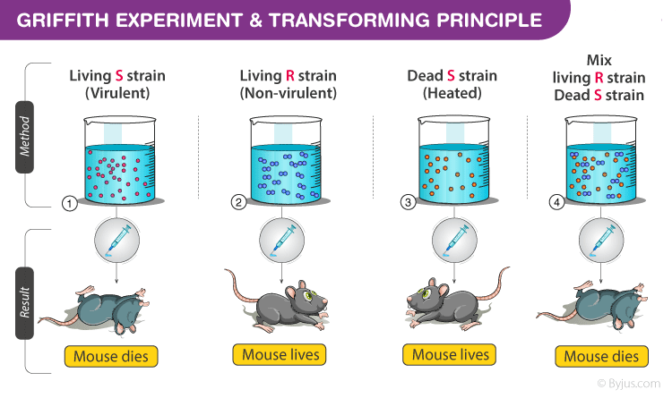

Slide 33
Biochemical Characterization of Transforming Principle
Initially genetic material thought as protein until the work of Oswald Avery, Colin MacLeod & Maclyn McCarty- 1933-44
They work to determine- biochemical nature of ‘transforming principle’-
Griffith’s experiment
Their work included- purification of biochemical- protein, DNA, RNA from heat killed S strain cells- determine the factor responsible of transformation of R strain to S strain
Work concluded- DNA from heat killed S stain bacteria cause R
bacteria to transform
When protein digesting enzymes (proteases) & RNA digesting enzyme (RNases) is mixed with heat killed S bacteria- transformation of R bacteria to S bacteria does take place
Digestion of DNA with DNase- inhibit transformation- suggest DNA cause transformation
They concluded DNA as hereditary material- not biologist were convinced

Slide 34
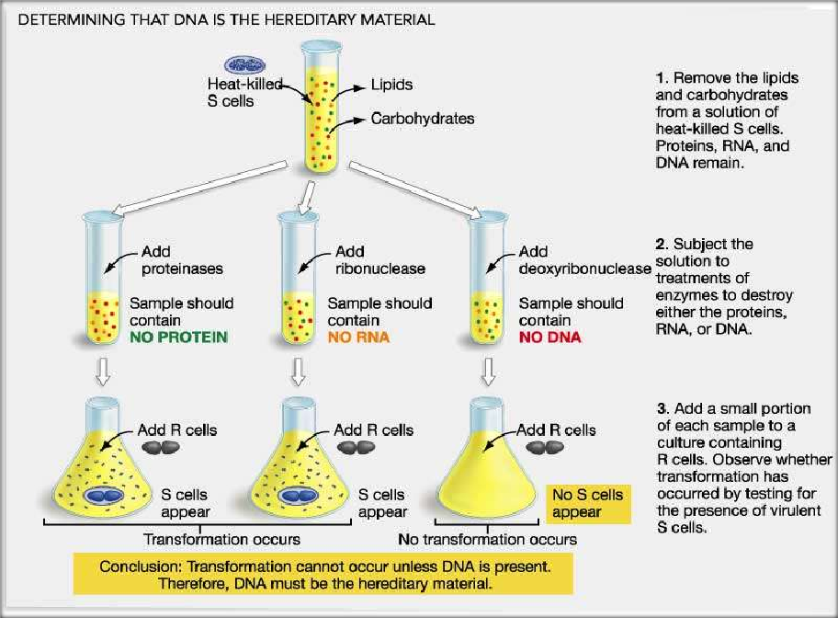

Slide 35
The Genetic material is DNA
Alfred Hershey & Martha Chase (1952)- proved DNA as the genetic material
Worked with Bacteriophages (virus)- infects bacteria
Bacteriophage attaches to bacteria & injects its genetic material into bacteria- viral genetic material incorporates itself to bacterial DNA- many new viral particles are formed
Hershey & Chase worked to discover- whether ‘protein or DNA’ of
virus has entered the cell
Experiment of Hershey & Chase
Grew some virus on medium containing radioactive phosphorus
(³² P) & some other in medium containing radioactive sulfur (³⁵ S)
DNA contains phosphorous & protein does not; likewise Sulfur is present in protein not in DNA

Slide 36
Virus grown in the presence of radioactive phosphorus- radioactive
DNA not radioactive protein
Virus- presence of radioactive sulfur- radioactive protein not radioactive DNA
Radioactive phages- allowed to attach E. coli bacteria to continue the infection; viral coats were removed from bacteria- agitating the culture in blender
Virus particles- separated from bacteria- centrifuge
Observation
Bacteria infected with virus with radioactive DNA were radioactive,
supernatant- non radioactive
Bacteria infected with virus with radioactive protein were not
radioactive, supernatant- radioactive
Conclusion
DNA is the genetic material that is passed from virus to bacteria
Protein is not the genetic material

Slide 37
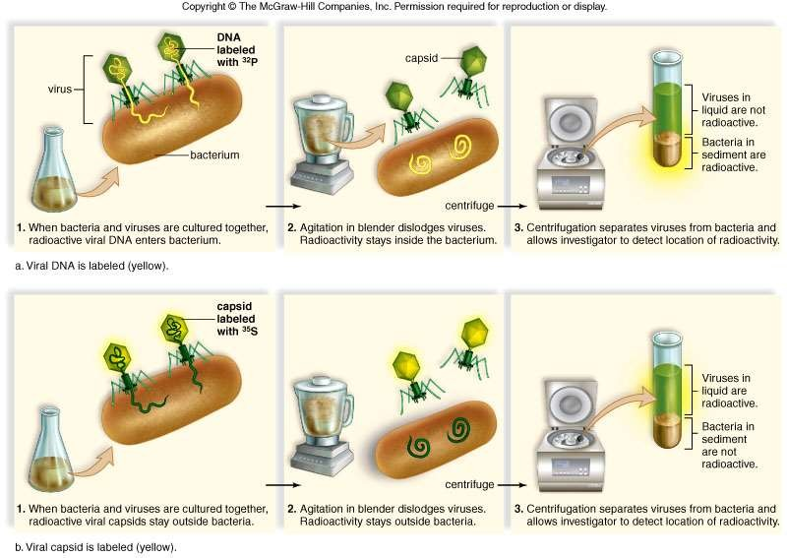

Slide 38
Properties of Genetic Material (DNA vs RNA)
Experiment of Hershey & Chase- proved DNA acts as genetic material
Subsequent studies showed RNA as genetic material of viruses
( Eg. Tobacco Mosaic Virus, QB Bacteriophage)
A molecule to act as genetic material have following criteria:
It should be able to generate its replica (Replication)
It should chemically & structurally be stable
Provide the scope for slow changes (mutation)- required for evolution
Should be able to express itself in the form of ‘Mendelian Characters’
Replication:
Replication refer to duplications
Nucleic acids (DNA & RNA)- ability to duplicate due to base pairing & Complementarity
Other biomolecule (protein) cannot undergo duplication

Slide 39
Stability:
Genetic material should be stable- should not change with different
stages of life cycle, age, change in physiology
Stability of genetic material was evident with Griffith’s ‘transforming principle’- heat killed the bacteria but didn’t destroy the properties of genetic material- can be explained as DNA strands (complementary) separate when heated & pair again at appropriate conditions
RNA- 2’ OH group at every nucleotide is reactive- RNA labile & easily degradable
RNA is known to be catalytic- reactive
DNA- chemically less reactive & structurally more stable than RNA which makes DNA better genetic material
Presence of Thymine in place of Uracil- adds stability
Mutation:
Both DNA & RNA- mutate
RNA- unstable mutate faster; Virus with RNA genome- shorter life
span- prone to mutation & evolve

Slide 40
Protein Synthesis ( Genetic Expression):
RNA directly codes for synthesis of protein- express characters easily
DNA- dependent on RNA for protein synthesis
Protein synthesis machinery- evolved around RNA
Conclusion
DNA & RNA- function as genetic material
DNA being more stable preferred as storage of genetic information
RNA- transmission of genetic information

Slide 41
RNA World
What is the first genetic material? DNA / RNA
Evidences suggests essential life processes like metabolism,
translation & splicing evolved around RNA
RNA- genetic material in organism like Virus, also Catalyst of some
biochemical reactions in living systems
But as catalyst- unstable due to reactive 2’- OH group
DNA has evolved from RNA with some modifications
Modifications include- double stranded nature & complementary
strand- resist the changes by evolving the process of repair

Slide 42
Replication
“It is the process by which DNA produces the exact copies of the original DNA."
Replication takes place during S- phase of cell cycle
Proposed by Watson and Crick following the double helical structure
Watson & Crick’s original statement (1953) states:
“It was not escaped our notice that the specific pairing we have postulated immediately suggests a possible copying mechanism for the genetic material”
They suggested DNA replication- Semi- conservative method
Described process- two DNA strand separate & act as template for synthesis of new complementary DNA strand- complementary base parind
New DNA molecule formed have- one parental DNA strand & one newly synthesized daughter DNA strand

Slide 43
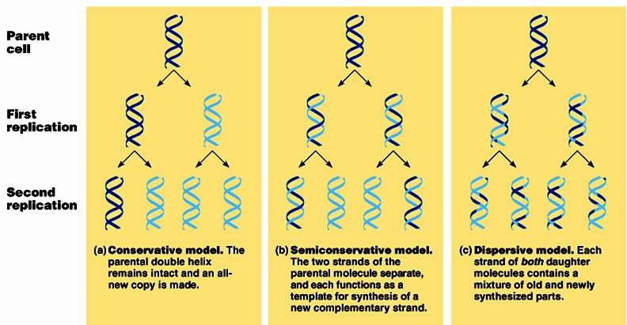
DNA Replication Pattern

Slide 44
Conservative replication
would leave intact the original DNA molecule
and generate a completely new molecule.
Dispersive replication
would produce two DNA molecules with sections
of both old and new DNA interspersed along each strand.
Semiconservative replication
would produce molecules with both old and
new DNA, but each molecule would be composed of one old strand and one new strand.

Slide 46
Matthew Meselson and Franklin Stahl experiment
They grew E. coli on ¹⁵ NH₄Cl culture medium. ¹⁵N is the heavy isotope of nitrogen- gets incorporated in the new DNA synthesized
Both strands of DNA have ¹⁵N (¹⁵N ¹⁵N)- 0 Minute
DNA extracted- subjected to CsCl density gradient centrifugations after every definite interval
Samples separated independently in CsCl gradients based on difference
in their densities
Bacteria is then shifted to ¹⁴NH₄Cl culture medium- ¹⁴N is light isotope of Nitrogen
DNA extraction, centrifugation with CsCl- after 20 minutes- First generation (I)
DNA extracted from first generation (¹⁵N to ¹⁴N) - Hybrid/ Intermediate type of DNA (¹⁵N ¹⁴N)- 20 Minute
Second generation- equal amount of light DNA (¹⁴N ¹⁴N) and hybrid DNA (¹⁵N ¹⁴N) are formed.- 40 Minute

Slide 47
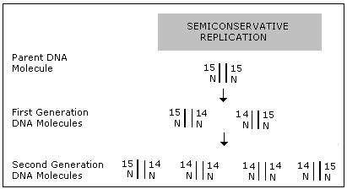

Slide 48
DNA Replication- Introduction
Enzymes are involved in the process of replication
Action of replication take place with high accuracy to avoid mutation
DNA polymerase- main enzyme and is DNA dependent since DNA act as template & catalyse polymerization of deoxyribonucleotides
E. Coli – 4.6 x 10⁶ bp, replication completes- 38 minutes
Polymerase- have to be fast & should catalyse reaction with high degree accuracy
Deoxyribonucleoside triphosphate- substrate & provide energy for
polymerization

Slide 49
DNA Replication
Components Essential For Replication:
Enzymes- Helicase, Topoisomerase, Primase, DNA Polymerase,
DNA ligase, Repair enzymes
Nucleotides- Deoxyribonucleotides
Energy- ATP & Deoxyribonucleoside triphosphate
The steps involved in the process of DNA replication includes:
Origination of replication
Unwinding of DNA molecule
Formation of RNA primer
Synthesis of complementary strand
Proof reading and DNA repair

Slide 50
1. Origination of Replication
Replication starts at a small opening of DNA helix as a complete DNA cannot be separated
initiation points or origin- hydrogen bond between two bases breaks
2. Unwinding of DNA molecule
Enzyme Helicase- unwinds & separate two strand
Involves breaking weak hydrogen bond
Energy required- ATP
Enzyme Topoisomerase- cut and reseal one strand of DNA strand helping separation of interwined strand of long DNA molecule
Leads to formation of Y- shaped replication fork
3. Formation of RNA primer
RNA primer- short segment of RNA nucleotide formed at DNA template before replication begins
Initiates the formation of new complementary DNA strand- 3’ end

Slide 51
4. Synthesis of New Complementary strand:
After formation of RNA primer- new nucleotides are added to RNA primer- DNA polymerase- add nucleotides in 5’→3’ only
New complementary strand proceeds from 3’ -OH terminus of the primer
causing extension in 5’→ 3’ direction
Building blocks for polymerization- deoxyribonucleotide triphosphate (dATP, dTTP, dGTP, dCTP)
Replication proceeds in 5’→ 3’ in one strand having template polarity
3’→ 5’- leading strand- Polymerase enzyme produce continuous strand
since replication is continuous
Opposite parental DNA strand with template polarity 5’→ 3’ – antiparallel; DNA polymerase produces short sections of DNA strand (5’→3’) - these short fragments of DNA strand- lagging strand/ discontinuous strand & fragments are called Okazaki fragments
Okazaki fragments/ DNA fragments- joined by DNA ligase

Slide 52
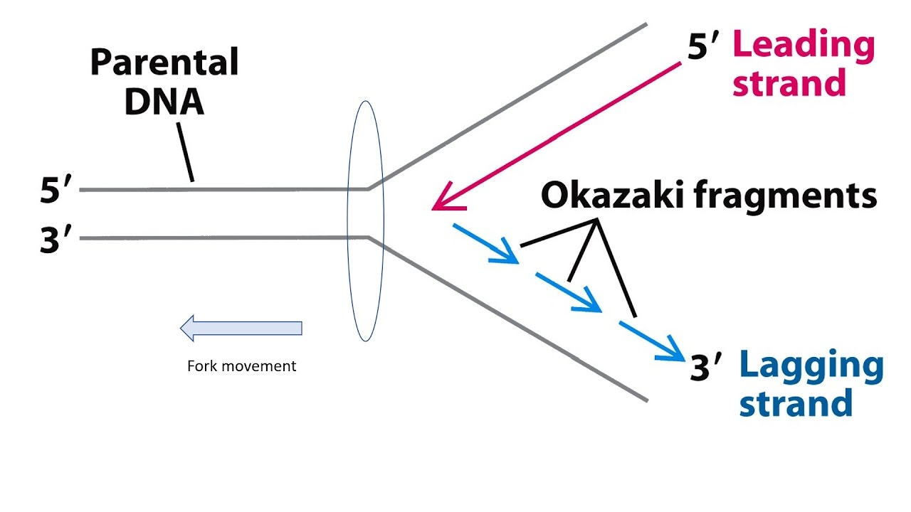

Slide 53
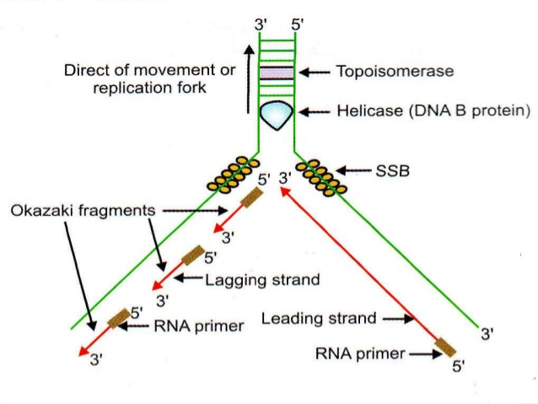

Slide 54
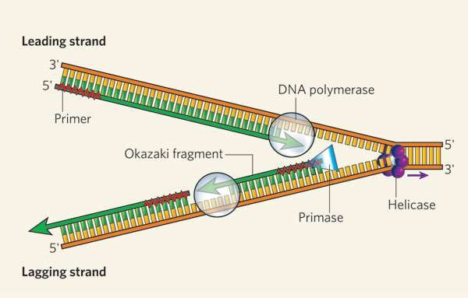
5. Proof reading and DNA repair:
Accuracy of base pairing is essential to avoid mutation
Any error one in 10,000 is also rectified by removing wrong base & replacing correct base
DNA polymerase- remove & replace any wrong base in the newly
synthesized strand
Repair enzyme (Nuclease)- cut off any defection in strand
Proof reading ensures identical DNA strand

Slide 56
Transcription
Process of copying genetic information from one strand of DNA into single stranded RNA
Depends upon the principle of complementarity (C::G & A::U), in RNA
strand in place of Thymine, Uracil is present
Only a segment of DNA and only one of the strand of DNA is copied into RNA, so it is very necessary to define the region on DNA that should be transcribed
Both DNA strands cannot be transcribed into RNA due to following reason:
If both strand act as template, they produce 2 different RNA molecule with different sequence (complementarity); they code for two different protein since the amino acids of both RNA transcribed are different & one segment of DNA will code for two different proteins- complicate genetic information
Two RNA molecules produced simultaneously- complementary- double
stranded RNA- this prevent RNA translation to protein

Slide 57
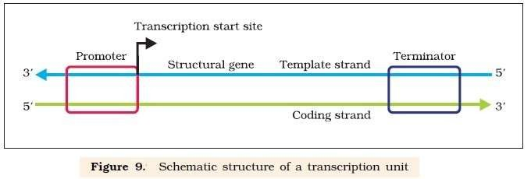
Transcription unit
Sequence of nucleotides in DNA that codes for a single RNA molecule, along with the sequences necessary for its transcription
The stretch of DNA transcribed into an RNA molecule is called
a transcription unit and encodes at least one gene
The 3 regions in transcription unit:
A Promoter- initiates the process of transcription- 5’ end, upstream
The Structural gene- codes of RNA- RNA polymerase
A Terminator- terminates transcription- 3’ end, downstream
Additional regulatory genes present upstream & downstream to promoter- regulate transcription

Slide 58
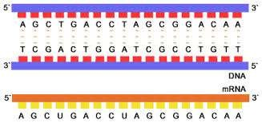
Transcription is the first step of gene expression, in which a particular segment of DNA is copied into RNA by the enzyme RNA Polymerase.
DNA base pairs of nucleotides as a complementary language that can be converted from DNA to RNA by the action of enzymes.
Both strands of DNA (antiparallel) is defined as structural gene in transcription unit
Enzyme DNA dependent RNA polymerase catalyse polymerization from
5’→3’ only
DNA strand with polarity 3’→5’ act as template- template strand
Opposite strand will have 5’→3’ polarity & have base sequences exactly same as the transcribed RNA (except thymine in place of uracil)- coding strand
All reference while defining transcription unit is made with coding strand

Slide 59
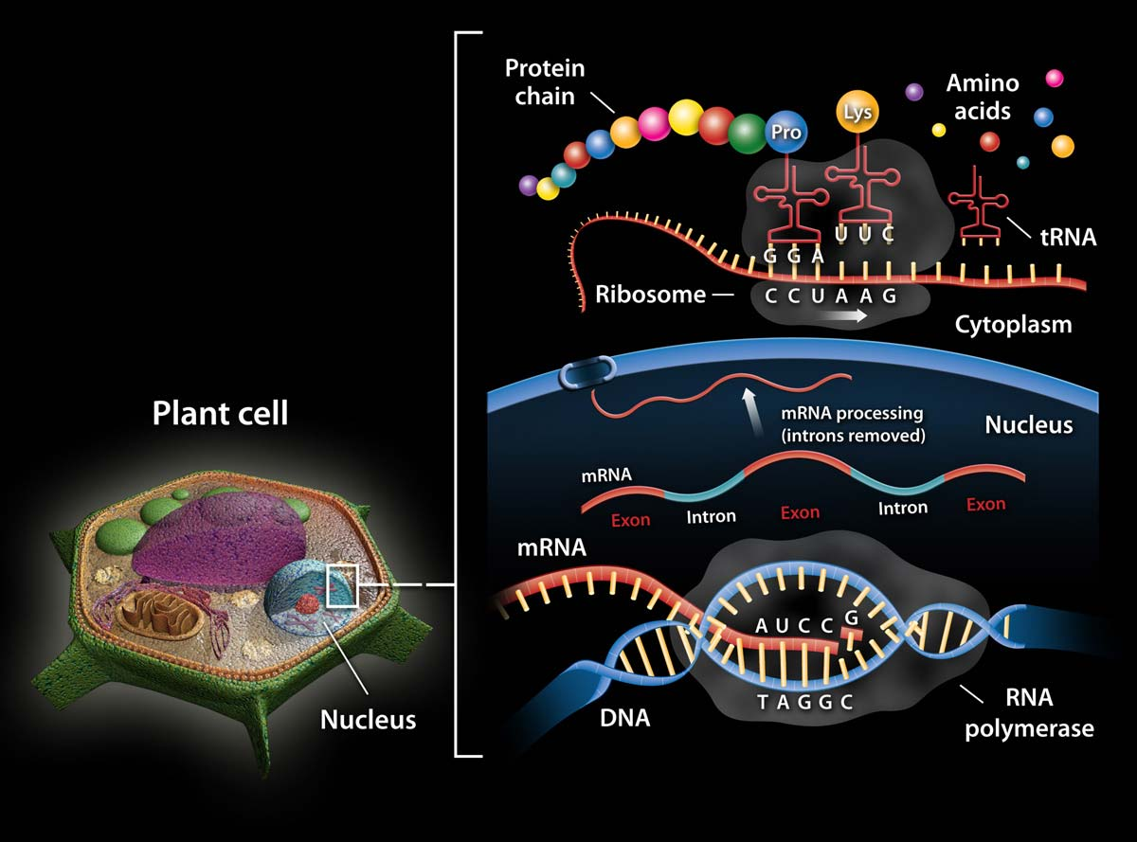

Slide 60
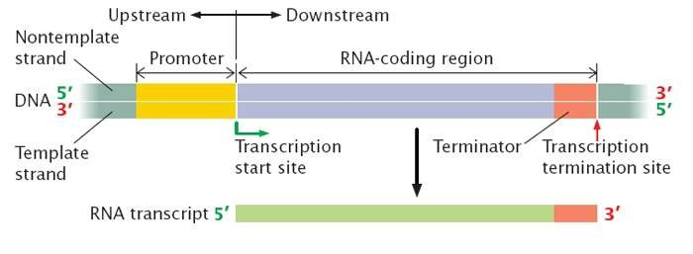
Promoter & terminator- flank structural gene i.e., located at either
end of structural gene
Location of promoter & terminator- polarity of Coding strand
Promoter
located 5’end, upstream of the structural gene
DNA sequence- provide binding site for RNA polymerase
Presence defines template strand & coding strand, when promoter position is switched with terminator, definition of coding & template strand is reversed
Terminator
Located towards 3’ end of structural gene (coding strand) , downstream
Defines the end of transcription

Slide 61
Transcription unit and gene
DNA - genes located- functional unit of inheritance
DNA sequence- codes for tRNA or rRNA & defined as gene
DNA sequence coding polypeptide- Cistron
Cistron- segment of DNA in the structural gene in the transcription unit coding for polypeptide (protein) which could be monocistronic (eukaryotes) / polycistronic (prokaryotes or bacteria)
Monocistronic structural gene-
genes which codes for only one mRNA & translates to one protein
(Eukaryotes)
Interrupted coding sequence i.e., genes are split
Coding/ expressed sequence- Exon (sequence which appear in mature/ processed RNA)
Exons- interrupted by introns- do not appear in mature or processed RNA
Polycistronic gene- genes which synthesize one mRNA but can translate more than one protein (Prokaryotes)
Regulatory gene- do not code for RNA/ Protein

Slide 62
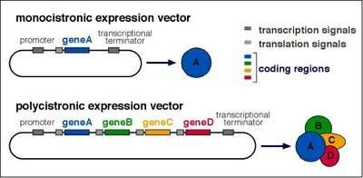

Slide 63
Types of RNA
Three types of RNA:
mRNA (messenger RNA)
tRNA (transfer RNA)
rRNA (ribosomal RNA)
RNAs- necessary for protein synthesis
mRNA- act as template for translation to protein
tRNA- brings amino acids for protein synthesis & reads genetic code
rRNA- structural & catalytic role during translation
DNA dependent RNA polymerase- catalyze transcription

Slide 64
Components essential for transcription
Components essential for transcription include:
RNA polymerase- binds to Promoter & initiates transcription
Nucleoside triphosphate- substrate & polymerizes in template depended fashion (complementarity)
During polymerization- RNA polymerase with short stretch of RNA binds with template strand
At terminator- nascent RNA with Polymerase falls off- Termination
The process of transcription includes:
Initiation
Elongation
Termination

Slide 65
Transcription in prokaryotes
Transcription in prokaryotes include 3 steps: initiation, elongation & termination
RNA polymerase catalyse polymerization
Enzyme Polymerase is capable- elongation only
Associates with initiation factor (σ sigma) for initiation process &
termination factor (ρ rho) to terminate transcription
Association of sigma & rho factor alters specificity of RNA polymerase- initiate & terminate transcription
mRNA transcribed does not require any processing to become active
Prokaryotes- nucleus & cytoplasm are not separate
Translation of mRNA begins before complete transcription of mRNA
So, transcription & translation is coupled in prokaryotes

Slide 66
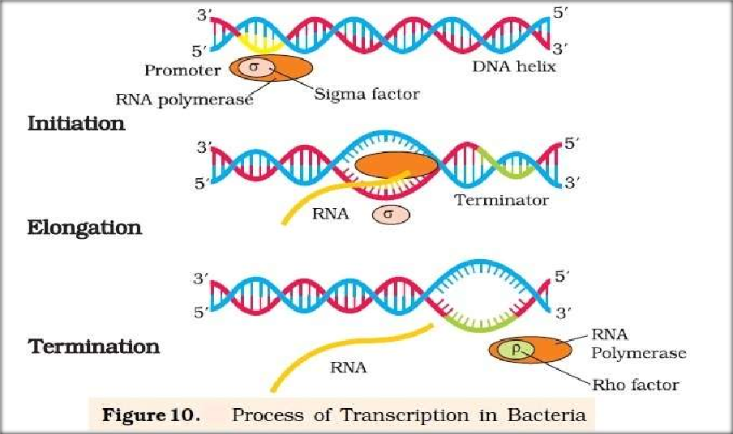
Transcription in Bacteria

Slide 67
Transcription in Eukaryotes
Components essential for transcription includes:
RNA polymerase: RNA polymerase I, RNA polymerase II & RNA
polymerase III- nucleus of cell
Nucleoside triphosphate
Structural gene of transcription unit- introns (does not appear) & exons
(appear as mRNA)
During transcription RNA polymerase I- rRNAs (28S, 18S & 5.8S)
RNA polymerase III- tRNA, 5S rRNA & snRNA(small nuclear RNAs)
RNA polymerase II- precursor of mRNA- heterogeneous nuclear RNA (hnRNA)
Precursor RNA or nascent RNA- hnRNA which undergo capping & splicing to form mRNA

Slide 68
Primary transcript have introns & exons- non functional- splicing
Splicing- introns are removed & exons joined in defined order
hnRNA- additional processing- capping & tailing
Capping- Methyl guanosine triphosphate added to 5’ end of hnRNA
Tailing- adenylate residues (Poly adenine 200-300 approx) added- 3’end in template independent manner- fully processed hnRNA
Fully processed hnRNA is called mRNA- transported out of nucleus for translation
Split gene arrangement & presence of introns- ancient feature of genome
Process of splicing- dominance of RNA world

Slide 69
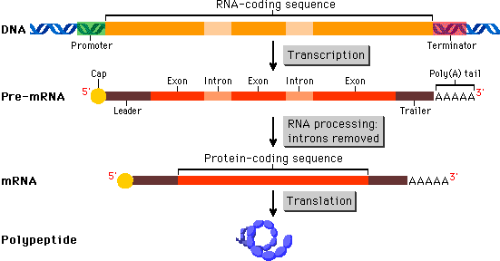

Slide 70
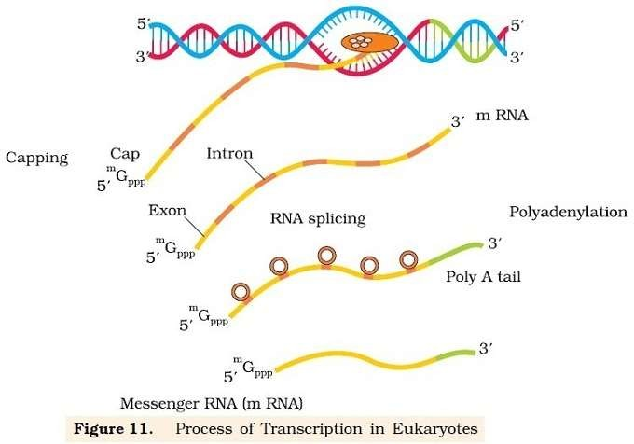

Slide 71
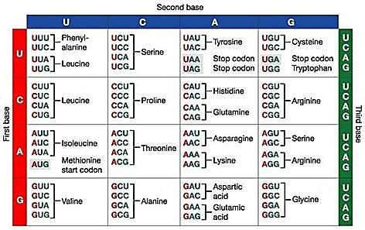

Slide 72
Genetic code
Is the genetic information required for translation of polymer of nucleotide to polymer of amino acids
Information are transferred in the form of codes.
This is ‘language’ of the genes, also known as the genetic code.
There are 20 different amino acids that make up of proteins in the body.
But there are only 4 different bases in the DNA and RNA. This would mean that one base cannot code for one amino acid since there are 20 amino acids available.
A sequence of 3 bases seem the most probable since it can give 64 codon (4³) possible combination of bases, this could count for the twenty amino acids available in organism.

Slide 73
General features of genetic code.
The genetic code is triplet: Each codon is made up of three specific nucleotides. 61 codon code for amino acids & 3 codon do not code for any amino acids & they function- Stop codon
Genetic codon is unambiguous & Specific- one codon codes for only one amino acids
Genetic code is universal: each codon codes for specific amino acid in all living organism. Eg.- UUU codes for Phenylalanine (phe)- bacteria & human
Genetic codons are no over lapping: Adjacent codon never shares there nucleotides.
Genetic code is comma less/ punctuation: There is no gap
(contiguous) between neighboring codon.
Genetic codon is degenerative in nature: more than one codon codes for single amino acid.
Ex GUA, GUG, GUC,GUU codes for valine.
AUG has dual function, codes for Methionine (met) & initiator codon

Slide 74
Genetic code: The three specific nucleotide sequence that codes for specific amino acid present in DNA is called genetic code.
Codon: The three specific nucleotide sequence that codes for
specific amino acid present in m-RNA is called codon.
Anti codon: The three specific nucleotide sequence that codes for specific amino acid present in anticodon arm of t-RNA is called anticodon.
Anticodons are complementary to codons.

Slide 75
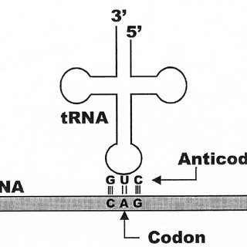

Slide 76
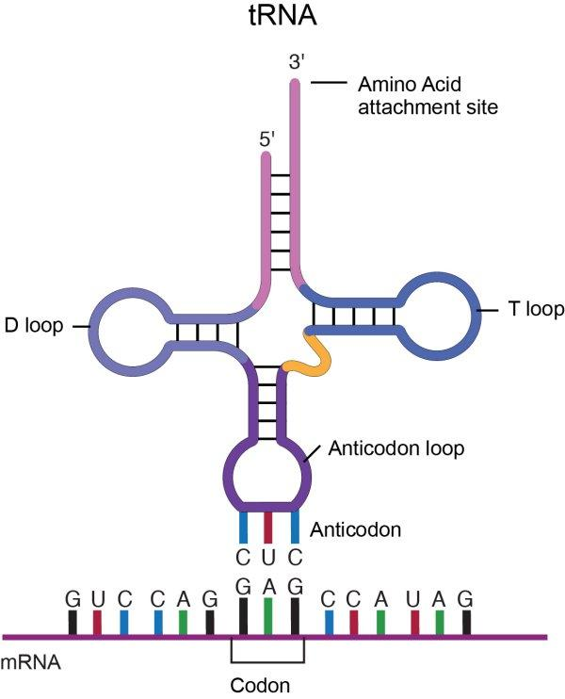

Slide 77
Initiator codon: AUG is the initiator codon that initiates the protein synthesis. It codes for amino acid methionine.
Terminator codon: Among 64 codon, three codon UAG, UGA, UAA does not codes for any amino acids. These are called terminator codon or non-sense codon.
Genetic code is unambiguous: Each codon codes for specific amino acid, and only one amino acid.
Ex: The codon UUU codes for the amino acid phenyl alanine only.
Genetic code is unidirectional: codon reads only in 5’ to 3’ direction.
Wobble base: In each codon third nitrogenous base is less specific.
Ex: GUA, GUC, GUG, GUU codes for valine.

Slide 78
Mutation and genetic code
Insertion or deletion of one or two bases changes the reading frame from the point of insertion or deletion- Point Mutation.
A classical example of point mutation is a change of single base pair in the gene for beta globin chain that results in the change of amino acid residue glutamate to valine. It results into a diseased condition called as sickle cell anemia
Insertion or deletion of three or its multiple bases insert or delete one or multiple codon hence one or multiple amino acids, and reading frame remains unaltered from that point onwards. Such mutations are referred to as frame-shift insertion or deletion mutations.

Slide 79
T RNA- the adapter molecule
tRNA (transfer RNA)- reads code on mRNA & binds amino acids for translation
tRNA also called sRNA (soluble RNA)- known before genetic code
was postulated
tRNA- specific for each amino acids
Structure:
Single stranded RNA
Clover leaf shaped- 2D & inverted L shaped- 3D
Four double stranded regions formed by hydrogen bonding between bases- 3 loops
Anticodon loop- three unpaired bases complementary bases (anti-
codon) to code bases of mRNA (codon)
Amino acid accepter end- amino acids binds
Initiator tRNA- initiation & has UAC anti codon
No tRNA- stop codon

Slide 80
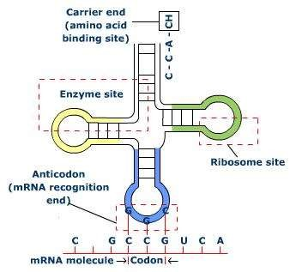
TRNA Structure

Slide 81
Translation
Process of polypeptide (protein) synthesis from amino acids added to one another as per message transcribed on mRNA
Polymerization of amino acids to form polypeptide & order and sequence of amino acids are defined by the sequence of bases in mRNA
Molecules Required for Protein Synthesis:
RNAs (mRNA, tRNA & rRNA)
Ribosomes
Enzymes

Slide 82
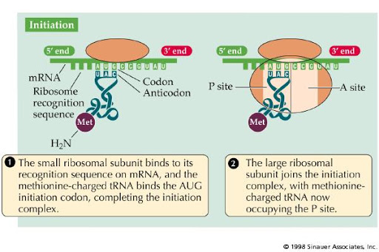

Slide 83
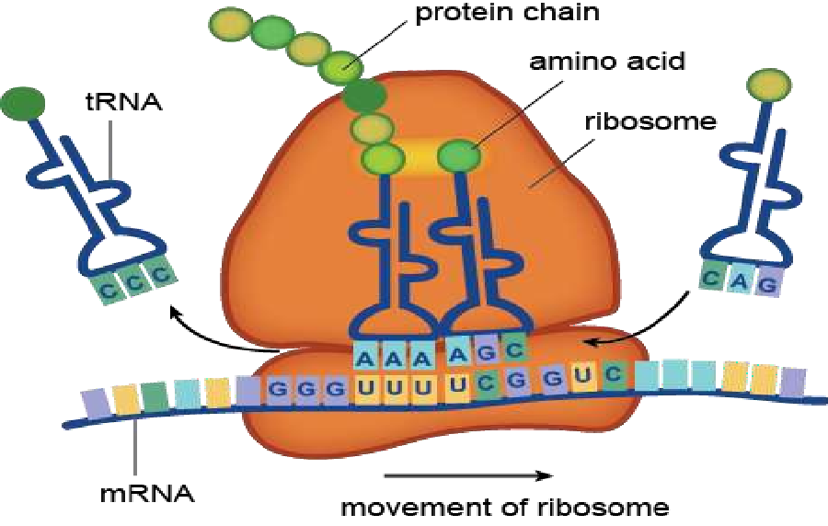
1. RNAs
mRNA- template for translation, have Untranslated regions (UTR)- 5’ (before start codon) & 3’ end (after stop codon)- efficient translation
tRNA- reads code & bring amino acids related to that
rRNA
2. Ribosomes
Responsible for protein synthesis in cell
Have structural RNAs & about 80 different protein
Have two subunits large & small; inactive- separate
Active: Small subunit attaches with mRNA to begin translation
Large subunit- two sites (P & A) for subsequent amino acids to bind & be close to form peptide bond
Ribosome (23S rRNA in bacteria )- acts as enzyme- ribozyme for formation of peptide bond

Slide 84
3. Enzyme
Enzyme involved- Amino acyl tRNA synhetase
Used for activation of amino acid
Steps involved in the Process of Translation
Activation of amino acids
Attachment of mRNA & formation of initiation complex
Initiation of polypeptide chain
Elongation of polypeptide
Termination

Slide 85
1. Activation of Amino acids & tRNA:
This process also called charging of tRNA/ aminoacylation of tRNA
Enzyme Aminoacyl tRNA synthase to form aminoacyl tRNA
complex
Require Mg⁺ to catalyse reaction
2. Attachment of mRNA & formation of Initiation complex:
mRNA attach with small sub- unit of ribosome at the Start codon
Translating mRNA- flanked with Start codon (AUG) & Stop codon
Methionine charged tRNA having anticodon UAC pairs with AUG of mRNA
Large sub- unit of ribosome joins & form complex- initiation complex
tRNA^{met} also called initiator tRNA occupies P site of large sub- unit

Slide 86
3. Initiation of Polypeptide
Synthesis of protein/ polypeptide
Initiation starts with amino acid methionine carrying tRNA/ initiator RNA when binds to P site & A site- empty with empty exposing codons of mRNA
4. Elongation of Polypeptide
Starts from 5’ to 3’
2nd tRNA charged with appropriate amino acid with anti codon of
exposed codon of mRNA, enters the complex & binds at A site
Peptide bond- formed between amino acid of P & A site (close) resulting- dipeptide
Linkage between Methionine & its carrying tRNA break & tRNA at A- site
carry di- peptide
tRNA at A site- pulled to P- site along with mRNA- translocation
Again A site gets exposed with another codon & relevant tRNA binds at A site- amino acid are linked & elongation continues

Slide 87
5. Termination:
Synthesis of polypeptide terminate- stop codon (UAA, UAG & UGA) of mRNA reach A- site
tRNA cannot recognize stop codon
tRNA at P- site releases polypeptide in presence of releasing factors
which binds stop codon
Dissociation of complex takes place

Slide 88
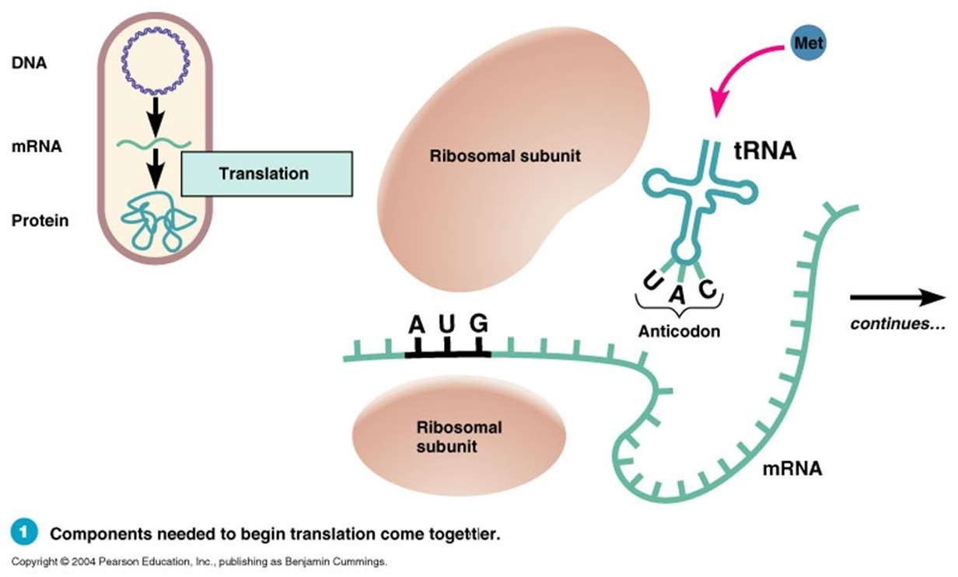

Slide 89
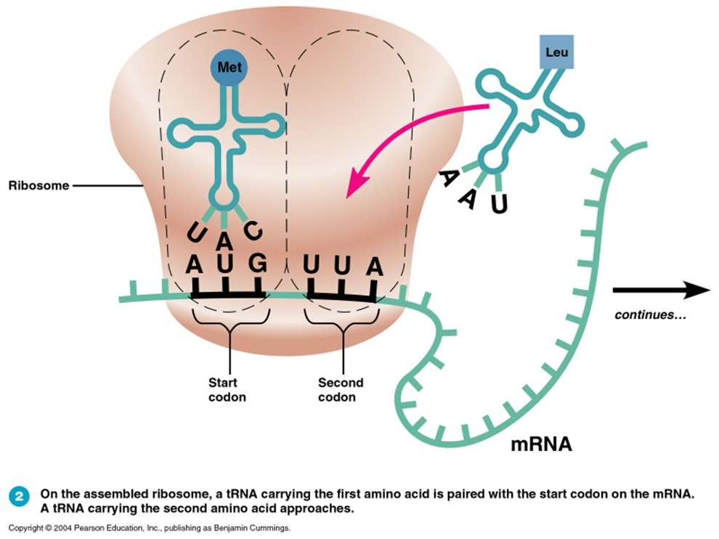

Slide 90
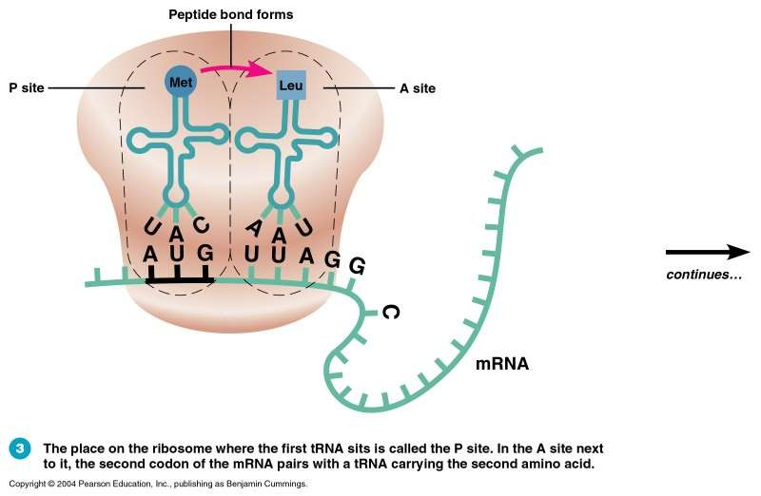

Slide 91
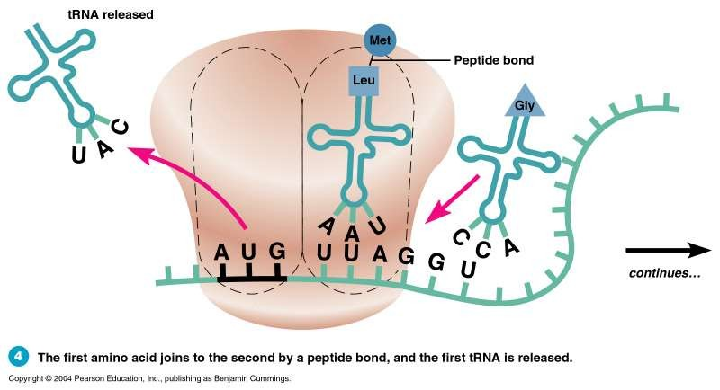

Slide 92
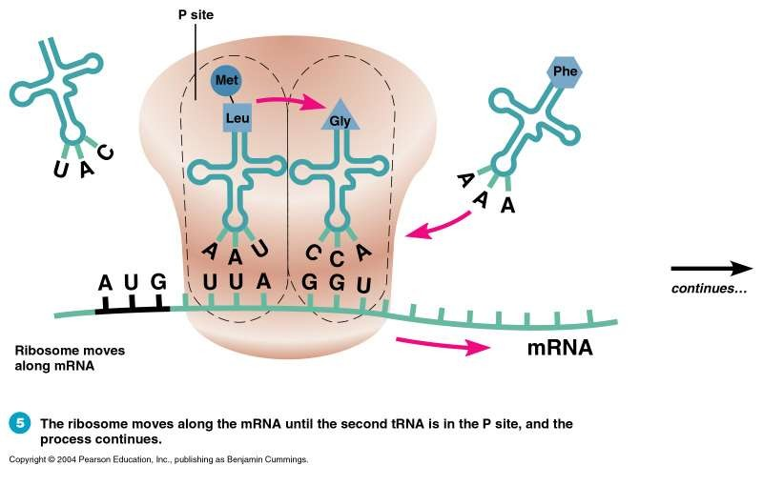

Slide 93
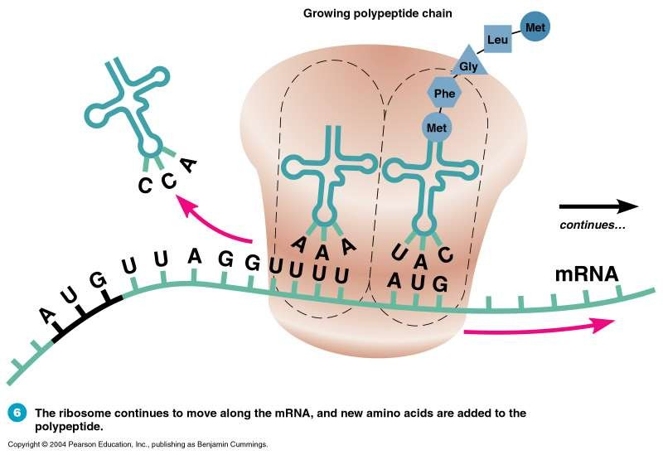

Slide 94
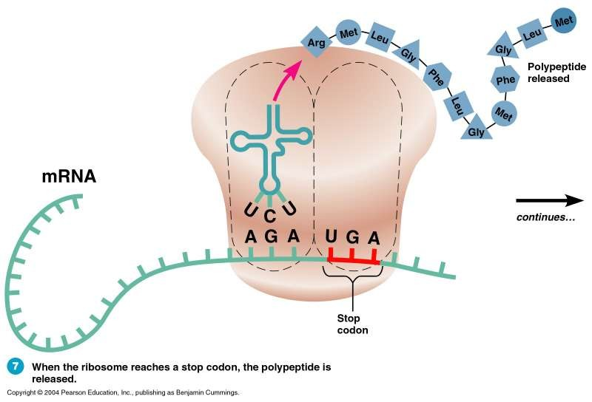

Slide 95
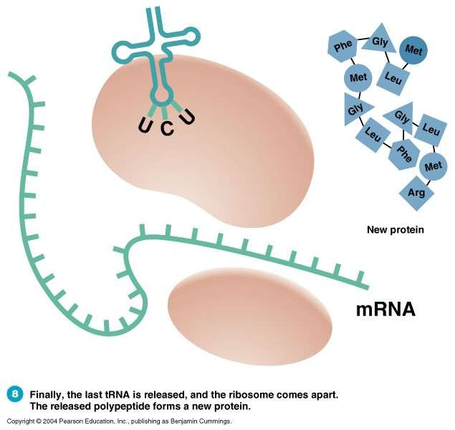

Slide 96
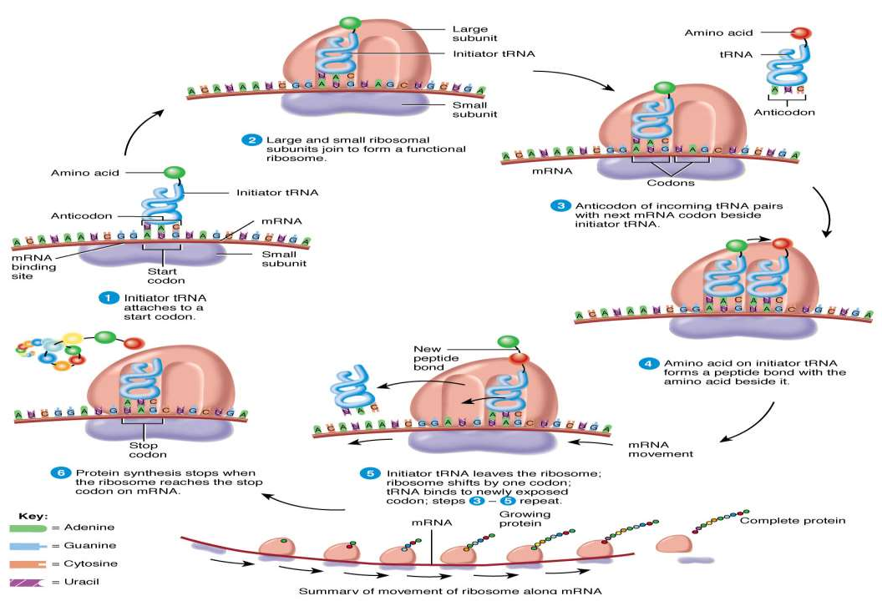

Slide 97
Regulation of gene expression
Gene expression is the process by which information from a gene is used in the synthesis of a functional gene product.
These products are often proteins, but in non-protein coding genes such as ribosomal RNA (rRNA), transfer RNA (tRNA) or small nuclear RNA (snRNA) genes, the product is a functional RNA
Several steps are involved in Gene expression: Transcription, RNA splicing, Translation & Post translation modification of protein
It regulates & form basis of cellular differentiation, morphogenesis,
adaptability of organism
Regulation of gene expression in Eukaryotes is exerted at:
Transcriptional level (formation of primary transcript)
Processing level (regulation of splicing)
Transport of mRNA from nucleus to cytoplasm
Translational level

Slide 98
Expression of genes can also be regulated by change in
physiological, metabolic & environmental conditions
Beta- galactosidase (enzyme)- present in E.Coli, catalyse hydrolysis of Lactose (disaccharide) into galactose & glucose which is utilized by bacteria for energy
When lactose are not around bacteria to use as energy, bacteria will not synthesize enzyme beta- galactosidase- explains physiological, metabolic & environmental conditions regulate gene expression
Development & differentiation of embryo into adult- coordinated regulation of expression of several sets of genes

Slide 99
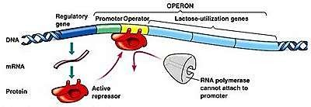
Prokaryotes- gene expression is controlled by the rate of
transcriptional initiation
RNA polymerase attaches at promoter of transcription unit- regulated by accessory/ regulatory protein- enable enzyme to recognize start site (promoter)
Regulatory protein- positively (activation) or negatively (repressor)
Accessibility of Promoter (prokaryotic DNA) also regulated- interaction of regulatory proteins with short DNA sequence- operators
Operator region- adjacent to promoter region in operons (A group of
genes or a segment of DNA that functions as single transcription unit.)
Most operon operator sequence binds with a repressor protein

Slide 100
OPERON
An operon is a functioning unit of genomic DNA containing a cluster of genes/structural genes under the control of a single promoter. The genes are transcribed together into an mRNA strand and translated together in the cytoplasm
An operon is made up of 4 basic DNA components:
Promoter – a nucleotide sequence that enables a gene to be transcribed; recognized by RNA polymerase, which initiates transcription.
Regulator– Genes control the operator gene in cooperation with certain compounds called inducers (metabolite). The regulator gene codes for and produces a protein substance called repressor. The repressor combines with the operator gene to repress its action.
Operator– a segment of DNA that a repressor binds to; a segment between the promoter and the genes of the operon. When repressor protein binds to it, it obstructs the RNA polymerase from transcribing the genes.
Structural genes– the genes that are co-regulated by the operon.
Eg.- lac operon, trp operon, ara operon, his operon, val operon

Slide 101
The lac operon
First investigated by geneticist Francois Jacob & biochemist Jacque Monod
Lac operon- polycistronic (prokaryotes) structural gene regulated by common promoter & regulatory genes
Lac operon- hydrolysis of lactose (disaccharide) to monosaccharide
galactose & glucose
Components of lac operon:
Regulatory gene- i gene
Three structural gene- z, y & a
Inducer- lactose (substrate)
Promoter- for regulatory gene (P_{i}) & for lac operon (P_{lac})

Slide 102
Lac operon- found in E.Coli
Promoter P_{i}- initiates the function of regulatory gene (i)
Promoter P_{lac}- initiates & regulates- lac operon
Lac operon- one regulatory gene (i- gene) & 3 structural genes (z, y & a)
i- gene codes for repressor of lac operon which repress transcription of structural gene
z- gene codes for beta- galactosidase (β- gal)- hydrolysis of lactose to galactose and glucose
y- gene codes for permease- increases permeability of cell to β- galactosides
a- gene codes for transacetylase- require for metabolism of lactose
All three structural genes are required for metabolism of lactose
Lactose- substrate for enzyme beta- galactosidase & regulates switching
on & off of the operon- inducer
Glucose- preferred by bacteria; in absence of glucose, lactose acts as substrate

Slide 103
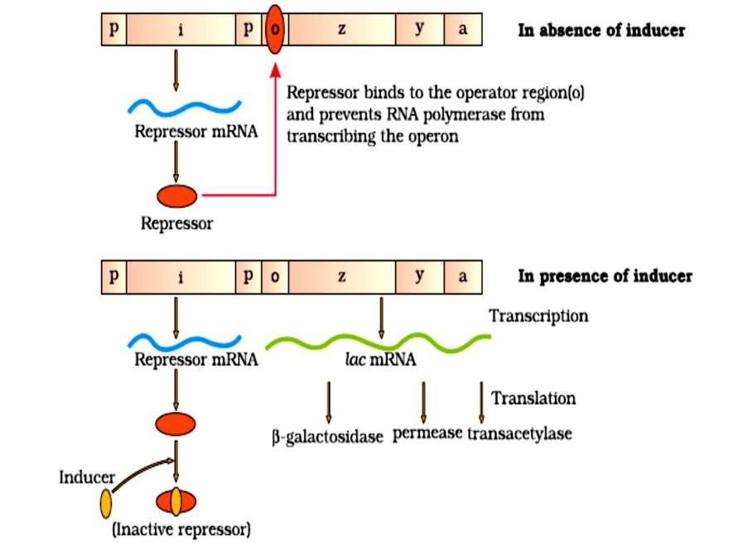

Slide 104
Inducers- lactose or allolactose
lactose is present in medium- transported into cell through permease
Lactose- induces activation of lac operon
In the absence of inducer (Lactose):
i- gene synthesize Repressor mRNA all the time which translate to
Repressor protein
Repressor protein- binds to operator region of operon & prevents RNA polymerase to transcribe structural genes of operon (z, y & a)
In the presence of inducer (Lactose):
Inducer interacts with repressor and inactivates repressor- disable its ability to bind to operator
Enable RNA polymerase to access promoter & transcription of structural gene proceeds to produce lac mRNA which translates to β- galactosidase, permease & transacetylase
Regulation of lac operon by repressor is referred as negative
regulation

Slide 106
Human genome project
Launched in 1990 to sequence human genome
GENOME – The whole hereditary information of an organism that is
encoded in the DNA
Project was based on the assumption – DNA sequence should be different at some places since individual differ from each other
Was called mega project due following reasons:
Human genome- 3x 10⁹ bp approx., cost of single base pair sequence-
US $ 3, then estimated cost for project- 9 billion US dollars
Obtained sequences if typed in book to store; with 1000 letters per page & 1000 pages per book then, 3300 books are required to store information of DNA sequence from a single human cell
Enormous data expected to generate require high speed computational devices for data storage & retrieval and analysis
HGP- associated with Bioinformatics

Slide 107
Goals of hgp
Important goals of HGP:
Identify all the approximately 20,000-25,000 genes in human DNA
Determine the sequences of the 3 billion chemical base pairs that
make up human DNA
Store this information in databases
Improve tools for data analysis
Transfer related technologies to other sectors, such as industries
Address the ethical, legal, and social issues (ELSI) that may arise from the project.
HGP- 13 year project which was completed by 2003; coordinated by
U.S. Department of Energy and the National Institute of Health & the Wellcome Trust (U.K.); additional contributions came from Japan, France, Germany, China and others

Slide 108
Significance of hgp
Gave knowledge about effects of DNA variations among individuals
Study of DNA variations in individuals can be used to diagnose,
treat and prevent many human disorders
Learning of DNA sequence of non human organism- understanding natural capabilities which can be applied to solve challenges in health care, agriculture, energy production & environmental remediation
DNA of many non- human model were sequences- bacteria, yeast, Caenorhabditis elegans (a free living non- pathogenic nematode), Dorsophila (the fruit fly), plants (rice & Arabidopsis)

Slide 109
Methodologies
Two way to sequence DNA:
Identifying all genes that are expressed- Expressed Sequence Tags
(ESTs)
Sequencing whole set of genome- coding & non- coding sequence later different regions were assigned in sequence obtained based on its function- Sequence Annotation
Common method employed to sequence DNA- identifying expressed genes which require DNA fragmentation
DNA- long polymer of nucleotide; sequencing complete DNA has
technical limitations
Sequencing DNA require- host & vector
Host- bacteria & yeast- cloning DNA sequence which help in amplification of each DNA fragment
Vector- BAC (bacterial artificial chromosome) & YAC (yeast artificial
chromosome)- introducing DNA fragment into host for cloning

Slide 110
Steps involved includes:
Isolation of total DNA from a cell
Fragmentation of total DNA into small sizes
Cloning fragments of DNA in a host with the help of vector- significance of cloning is to amplify each piece of DNA to sequence DNA conveniently & with ease
Commonly used host- bacteria & yeast, Vector- BAC & YAC
Sequencing DNA fragments using automated DNA sequencer that
works on a principle developed by Frederick Sanger
Arrangement of DNA sequences based on overlapping regions which is generated for sequencing
Alignments of DNA sequence through computer based programs
Annotation & assigning sequence to each chromosome
Assigning genetic & physical map on genome- using information on polymorphism of restriction endonuclease recognition sites & microsatellites (repetitive DNA sequence)

Slide 112
Salient features of human genome
The human genome contains 3164.7 million nucleotide bases.
The average gene consists of 3000 bases, but sizes vary greatly, with the largest known human gene being dystrophin at 2.4 million bases.
The total number of genes is estimated at 30,000–much lower than previous estimates of 80,000 to 1,40,000 genes. Almost all (99.9 per cent) nucleotide bases are exactly the same in all people.
The functions are unknown for over 50 per cent of discovered genes.
Less than 2 per cent of the genome codes for proteins.
Repeated sequences make up very large portion of the human genome.

Slide 113
Repetitive sequences are stretches of DNA sequences that are repeated many times, sometimes hundred to thousand times. They are thought to have no direct coding functions, but they shed light on chromosome structure, dynamics and evolution.
Chromosome 1 has most genes (2968), and the Y has the fewest
(231).
Scientists have identified about 1.4 million locations where single base DNA differences (SNPs – single nucleotide polymorphism, pronounced as ‘snips’) occur in humans. This information promises to revolutionize the processes of finding chromosomal locations for disease-associated sequences and tracing human history.

Slide 114
Applications and future challenges
Knowledge of human genome sequence and researches will lead us to
understand biological systems in coming decades.
HG sequence will enable a complete new approach to biological research
With whole genome sequences & new high- throughput technologies, we
can approach questions systematically and on a much broader scale
It will be possible to understand how enormous number of genes and
proteins work together in interconnected networks in the chemistry of life.
HG sequencing is an enormous task which will require the expertise and creativity of tens of thousands of scientists from varied disciplines in both the public and private sectors worldwide.

Slide 118
DNA fingerprinting
DNA fingerprinting is a technique to find out variations in individuals of a population at DNA level & was first developed by Dr. Alec Jeffrey
Works on the principle of polymorphism in DNA sequence (A DNA polymorphism is any difference in the nucleotide sequence between individuals. These differences can be single base pair changes, deletions, insertions, or even changes in the number of copies of a given DNA sequence)
DNA finger printing involves identifying differences in a specific short nucleotide repeats called Variable Number Tandem Repeats (VNTR), that vary in number from person to person & are inherited
The VNTRs of two person may be of same length and sequence at certain sites but vary at others

Slide 119
Extraction & Isolation- DNA is extracted & isolated from the cells in
a high speed, refrigerated centrifuge
Amplification- Many copies of the extracted DNA are made by polymerase chain reaction (PCR)
Restriction digestion- DNA is cut into fragments with restriction endonuclease enzyme into precise reproducible sequence
Separation of DNA sequences- The cut DNA fragments are introduced & passed through electrophoresis set up containing agarose polymer gel; the separated fragments can be visualized by staining them with dye that shows fluorescence under ultraviolet radiation
Southern Blotting- The separated DNA sequences are transferred into nitrocellulose or nylon membrane by placing over the gel
Hybridization- The nylon membrane is immersed in a bath of radioactive probes (DNA segment of known sequence); these probes target a specific nucleotide sequence that is complementary to them
Autoradiography- The nylon membrane is pressed on to a x- ray film and dark bands develop at the probe sites which resemble the bar codes

Slide 120
Steps involved in DNA finger printing technology.

Slide 121
Application of DNA finger printing technology.
It is used to identify criminals and rapist.
To solve parental dispute.
To solve immigrant problems.
To identify dead bodies of soldiers died in wars.
To identify dead bodies of person died at accidents and bomb
blast.
To identify racial groups to rewrite biological evolution
To detect inheritable disorders.
To detect donor cell in case of transplantation.

